Slide 1
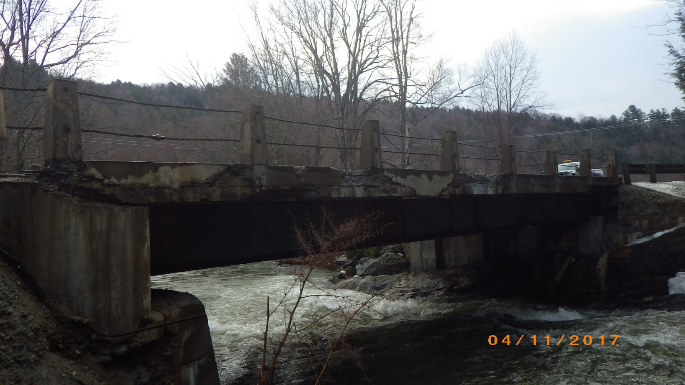
Stowe BO 1446(37) Selectboard Presentation Town Highway 43 – Bridge #51 over Miller Brook
March 25, 2019

Slide 2
Introductions
Carolyn Carlson, P.E.
VTrans Design Project Manager
Cory Burrall, P.E.
VTrans Project Design Engineer
Andrew Lemieux
VTrans Design Engineer

Slide 3
Purpose of Meeting
Provide an update to project development
Project overview and existing conditions
Proposed design and conceptual plans
Temporary bridge and maintenance of traffic
Discuss project impacts
Cost estimates
Project schedule and timeline
Provide an opportunity to ask questions and voice any concerns

Slide 4
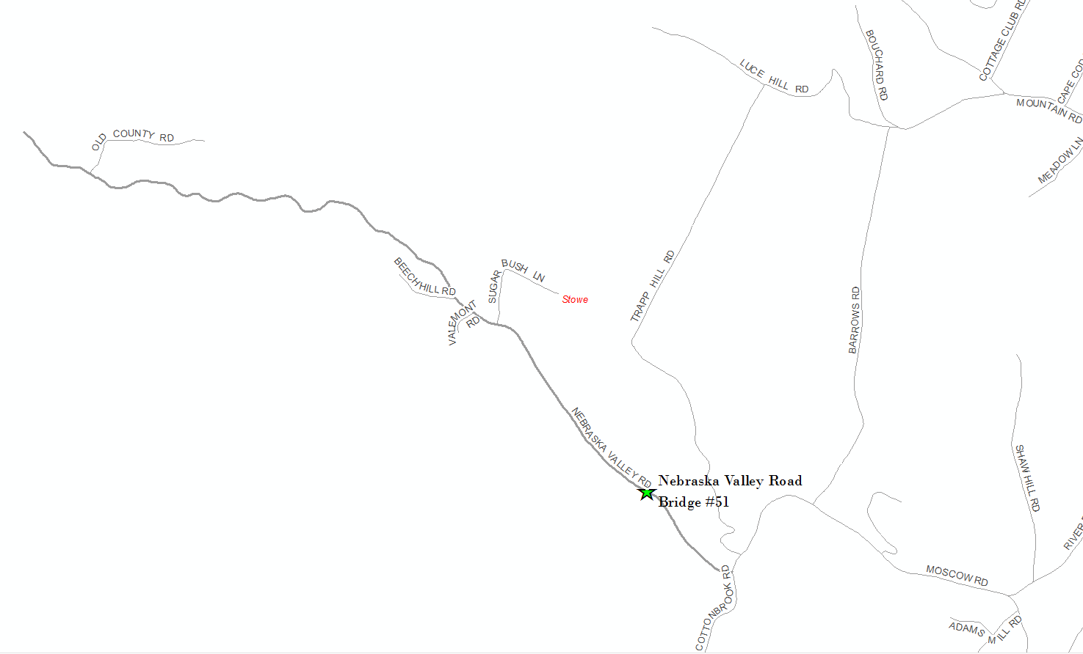
Location Map

Slide 5
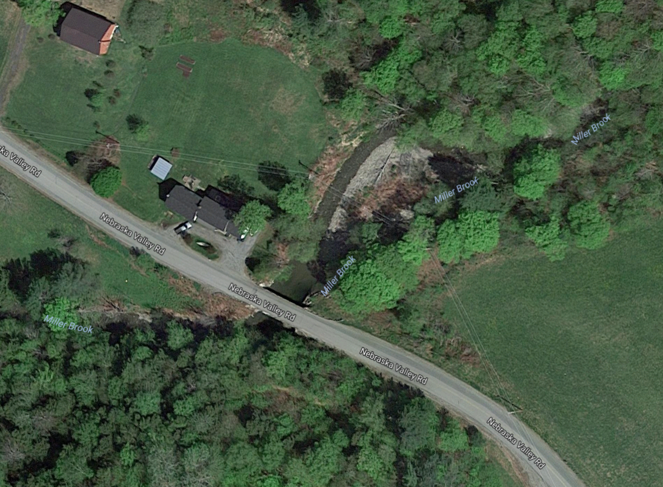
Bridge 51
Nebraska Valley Road
TH 3

Slide 6
VTrans Project Development Process
We are here
Project
Funded
Project
Defined
Contract
Award
Project Definition
Project Design
Construction
Identify resources & constraints
Evaluate alternatives
Public participation
Build Consensus
Quantify areas of impact
Environmental permits
Develop plans, estimate and specifications
Right-of-Way process

Slide 7
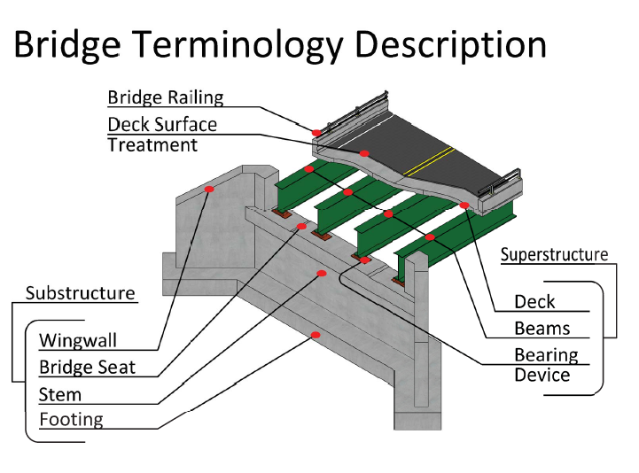
Project Overview

Slide 8
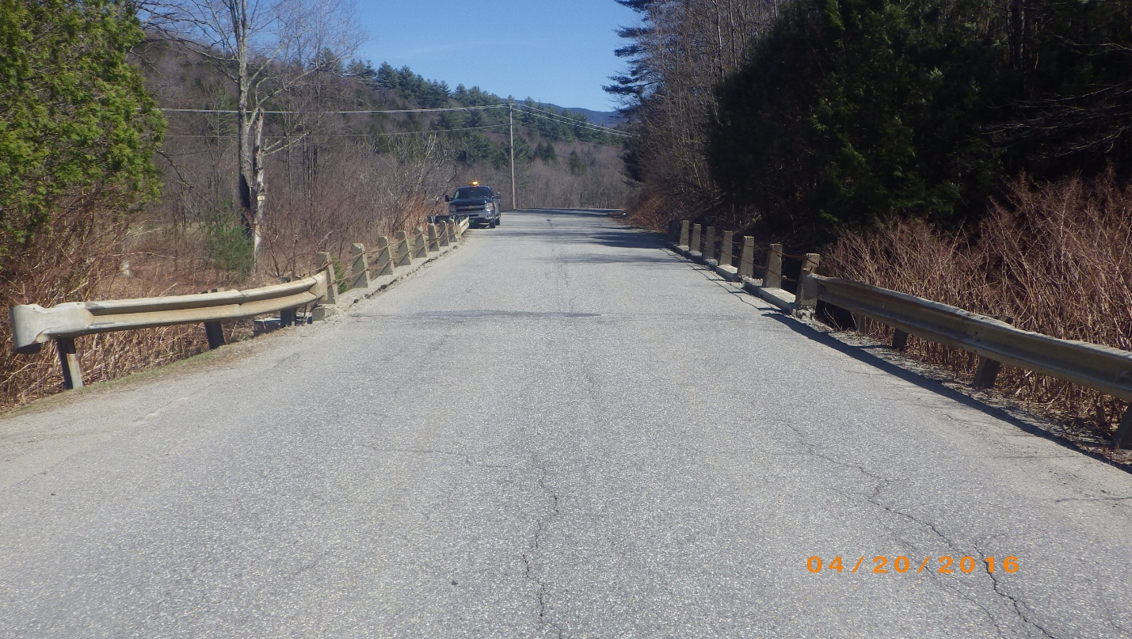
Looking East over Bridge
Bridge #51
Roadway Classification – Local Road (Class 3 TH)
Bridge Type – 54’ Span Rolled Beam Bridge
Ownership – Town of Stowe
Constructed in 1948

Slide 9
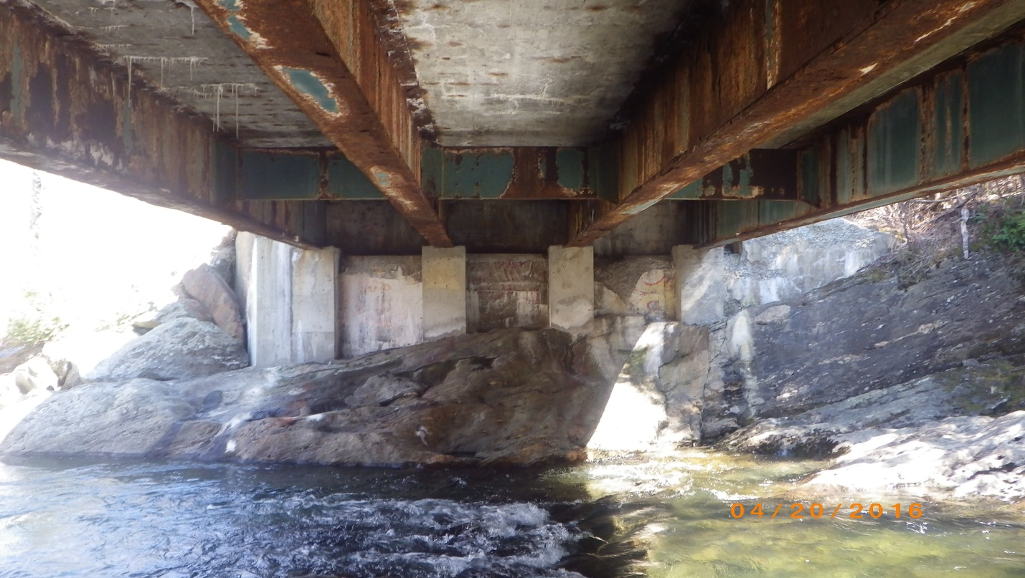
Deck & Superstructure Deterioration – Bedrock Outcrop @ Eastern Abutment
Existing Conditions - Bridge #51
Deck Rating 4 (Poor)
Superstructure Rating 6 (Satisfactory)
Substructure Rating 5 (Fair)
12-month Inspection Frequency

Slide 10
Design Criteria and Considerations
ADT of 430; DHV of 60
% Trucks: 3.4
Truck volume and nearby gravel pit
Waterway clearance
Low beam elevation less than 10 ft above river
Design speed of 35 mph
Site limitations and embankment for temporary bridge
Ledge removal
One Lane alternating with Traffic Signal
Right-of-Way needed; Utility relocation not needed
Adjacent property owners
Additional properties, businesses, archaeological sensitive areas, and recreational use

Slide 11
Proposed Bridge Replacement – Bridge #51
Full Bridge Replacement on Alignment with Traffic Maintained on Upstream Temporary Bridge
Maintain existing centerline of road
New concrete deck on 4 galvanized steel rolled beams
Widen Bridge to 9’/3’ typical to match corridor and provide bicycle accommodations
Exceeds the minimum standard (9’/2’)
Meets all geometric criteria - <1% slope over the bridge
2% roadway crown and fascia mounted bridge rail to promote runoff
Eastern abutment founded directly on bedrock with spread footing
Western abutment on piles
80 year design life
Construction – Summer 2022

Slide 12
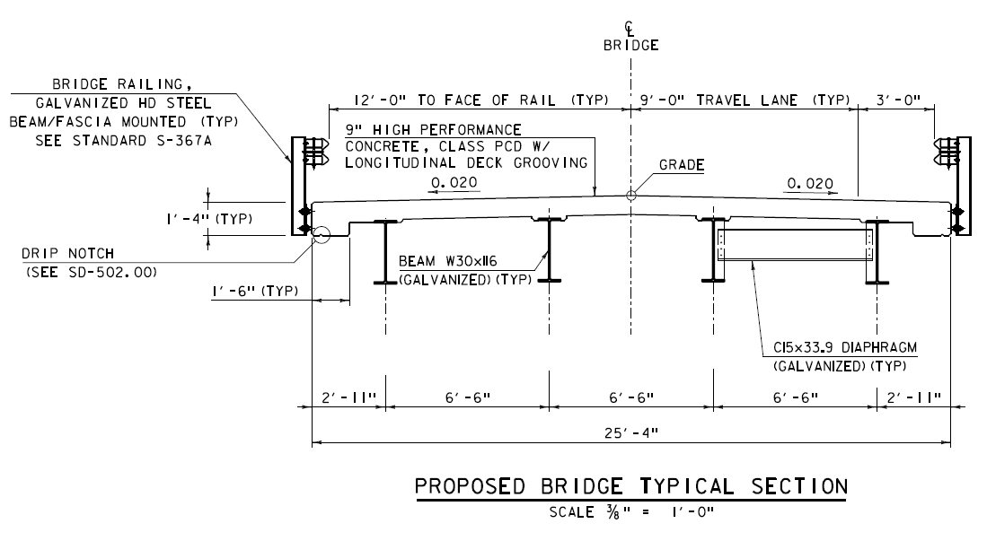
Proposed Typical Section

Slide 13
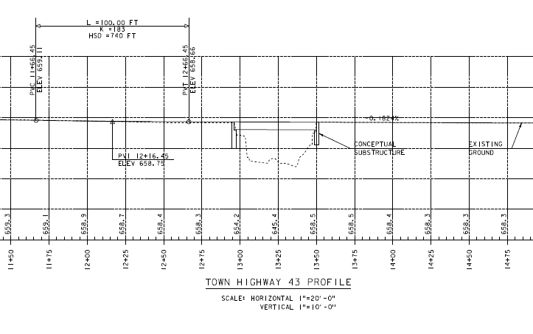
Proposed Profile

Slide 14
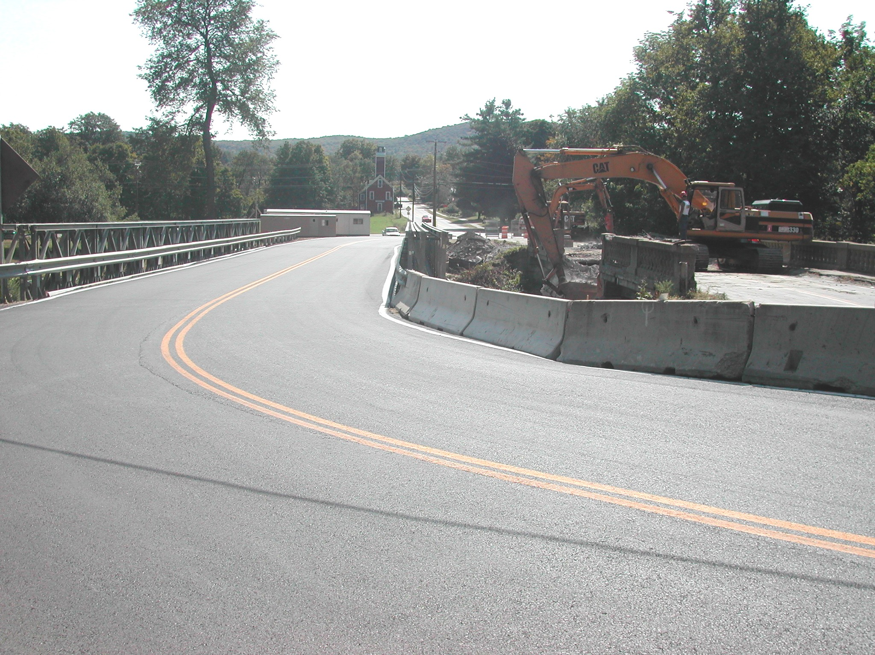
Temporary Bridge
One Lane Temporary Bridge with Traffic Signal
Upstream Temporary Bridge as preferred by Town
Temporary Bridge will require temporary ROW acquisition
Will require extensive embankment excavation due to site limitations

Slide 15
Proposed Bridge Layout
Temporary Bridge Preferred Option - Bridge #51
Upstream temporary has greater impacts and potential impacts to Northern Long Eared Bat Habitat
Longer Temporary Bridge required, solid rock excavation, additional cost
Notes:
original

Slide 16
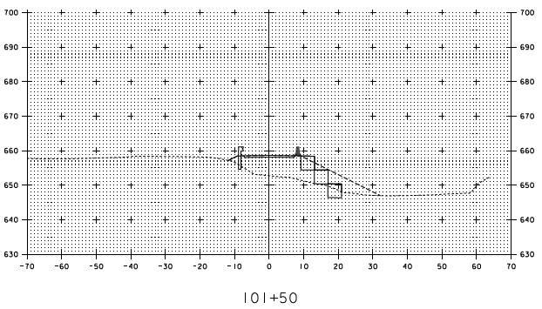
Cross Section of Slope Impact Western Abutment 1
Notes:
Mike considering blocks

Slide 17
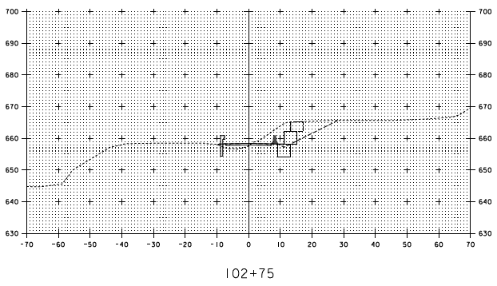
Cross Section of Slope Impact Eastern Abutment 2
Notes:
Mike considering blocks

Slide 18
Cost Estimates
Stowe BO 1446(37) Cost Estimate
Total Project Costs (Including E & C) | $1,942,231
Town Share | $194,223
Town % | 10%
Project Development Duration | 4 years
Construction Duration | Approximately 6 months (April to October)
Closure Duration (If Applicable) | N/A
Typical Section - Bridge (feet) | 3-9-9-3
Hydraulics | Meets Standard
Utility | No Change
ROW Acquisition | Yes
Design Life (Years) | 80
Notes:
?

Slide 19
Project Schedule
Stowe BO 1446(37) Development Schedule
Scoping | Complete
Conceptual Plans | Complete
Preliminary Plans | December 2019
Permitting | Winter 2020
Right-of-Way Clear | Spring 2021
Final Plans | April 2021
Contract Plans | July 2021
Bid Advertisement | September 2021
Contract Award | October 2021
Construction | April 2022 – October 2022

Slide 20
Stowe BO 1446(37) Questions and Comments Town Highway 43 – Bridge #51 over Miller Brook
For more information:
https://outside.vermont.gov/agency/vtrans/external/Projects/Structures/12J660
March 25, 2019

